Slide 1


Python For ML
#LifeKoKaroLift

Slide 2



Module Name - Introduction to Python
Class - Day 1
Topic - Getting Started with Python
EditEdit MasterMaster texttext stylesstyles

Slide 3

Time Allocation Summary
Element | Slides | Maximum time allowed (min)
Agenda | 4 | 5
Introduction | 5 - 11 | 10
Why Python | 12 - 13 | 15
What is Python | 14 | 10
Different IDEs and Code Editors for Python | 15 | 7
Why Anaconda | 16 | 10
Key takeaways | 17 | 3
Total Time |  | 60
Notes:
This slide is for instructor reference.

Slide 4

What is Python?
Why Python?
Different IDEs for Python
What and Why Anaconda?

Slide 5


CHATBOT
ShutterStockID-1141230461
ShutterStockID-1399145948
Notes:
Explain what is Chatbot
[Chatbot is a software/program for making conversations by either medium (audio or text). Famous chatbot is Amazon’s Alexa]

Slide 6
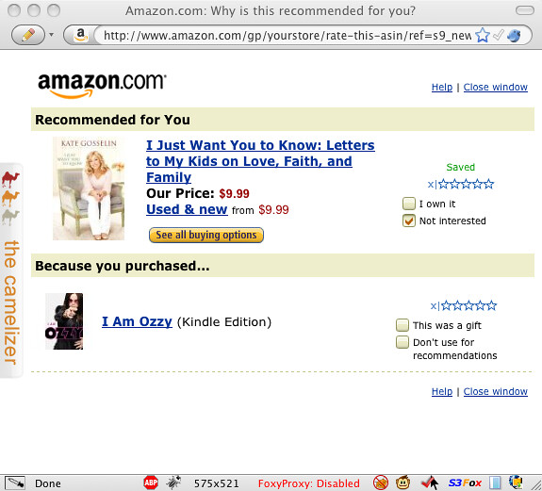

Recommendation System
ShutterStockID - 1488081986
Notes:
Explain what is Recommendation System
[Whenever you shop in Amazon or Flipkart or watch a movie in Netflix or Prime, the app recommends you a similar type of option or the most liked option in the same category. This is done by recommendation system.]

Slide 7

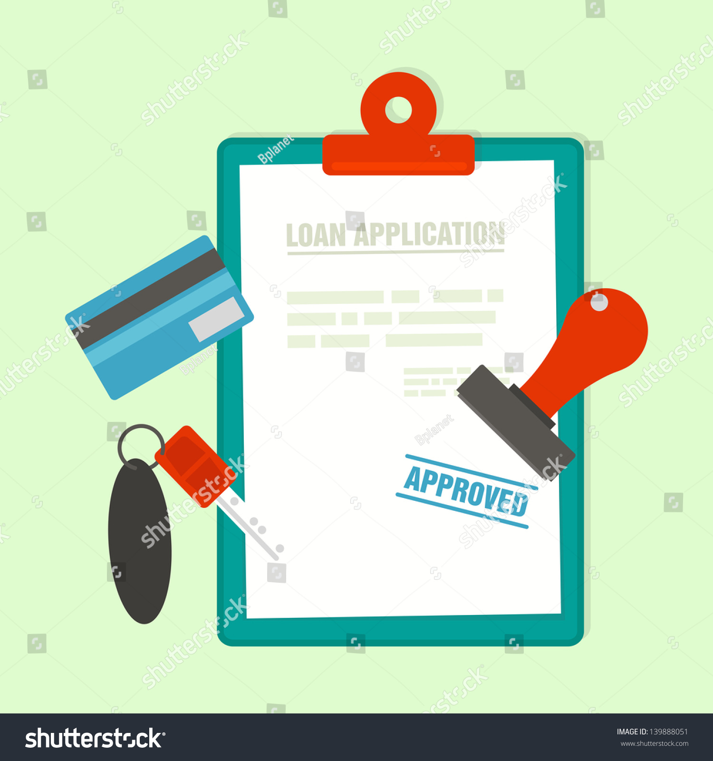
ShutterStockID- 512032066
ShutterStockID- 139888051
Notes:
Loan approval by bank is also done using machine learning

Slide 8

ShutterStockID - 1508632973
Notes:
The payments using internet via apps such as Google Pay, PhonePe etc. is also done with the help of concepts of Machine Learning.

Slide 9
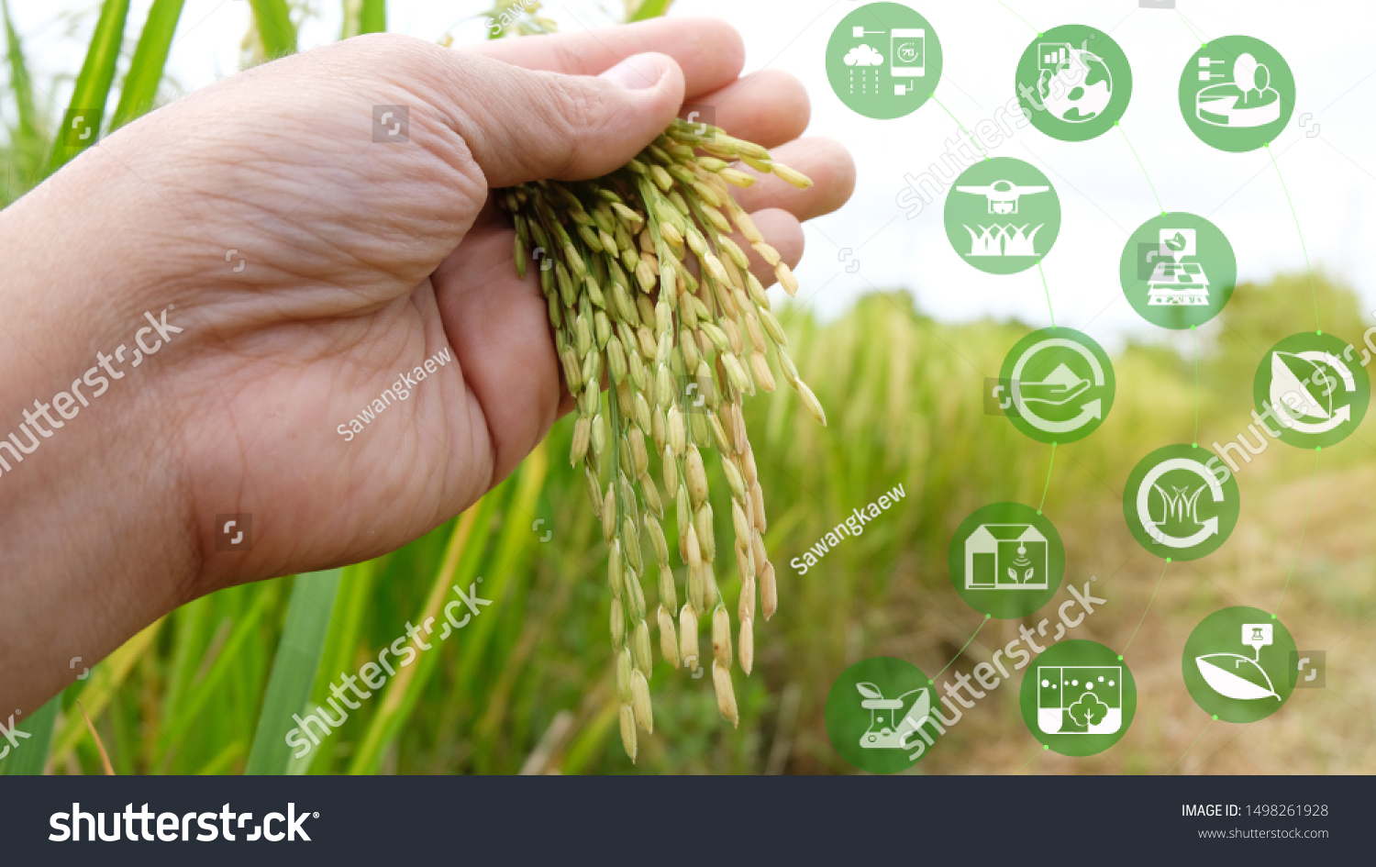
Agriculture
ShutterStockID - 1498261928

Slide 10



ShutterStock: 375341206
ShutterStock: 1265985457
ShutterStock: 699168370
Notes:
The famous applications such as Facebook, Uber, Grammarly also uses machine learning.

Slide 11
Introduction
These are all new age and technology examples which use concepts of Artificial Intelligence, Machine learning, Deep Learning etc.
The most common programming language used for coding these concepts is Python.

Slide 12
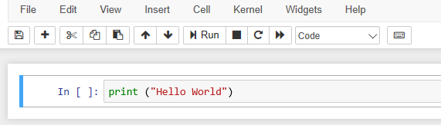
Why Python?
Code readability
Compatibility with different platform.
Interpreter system based code execution
Notes:
Explain each feature of Python

Slide 13
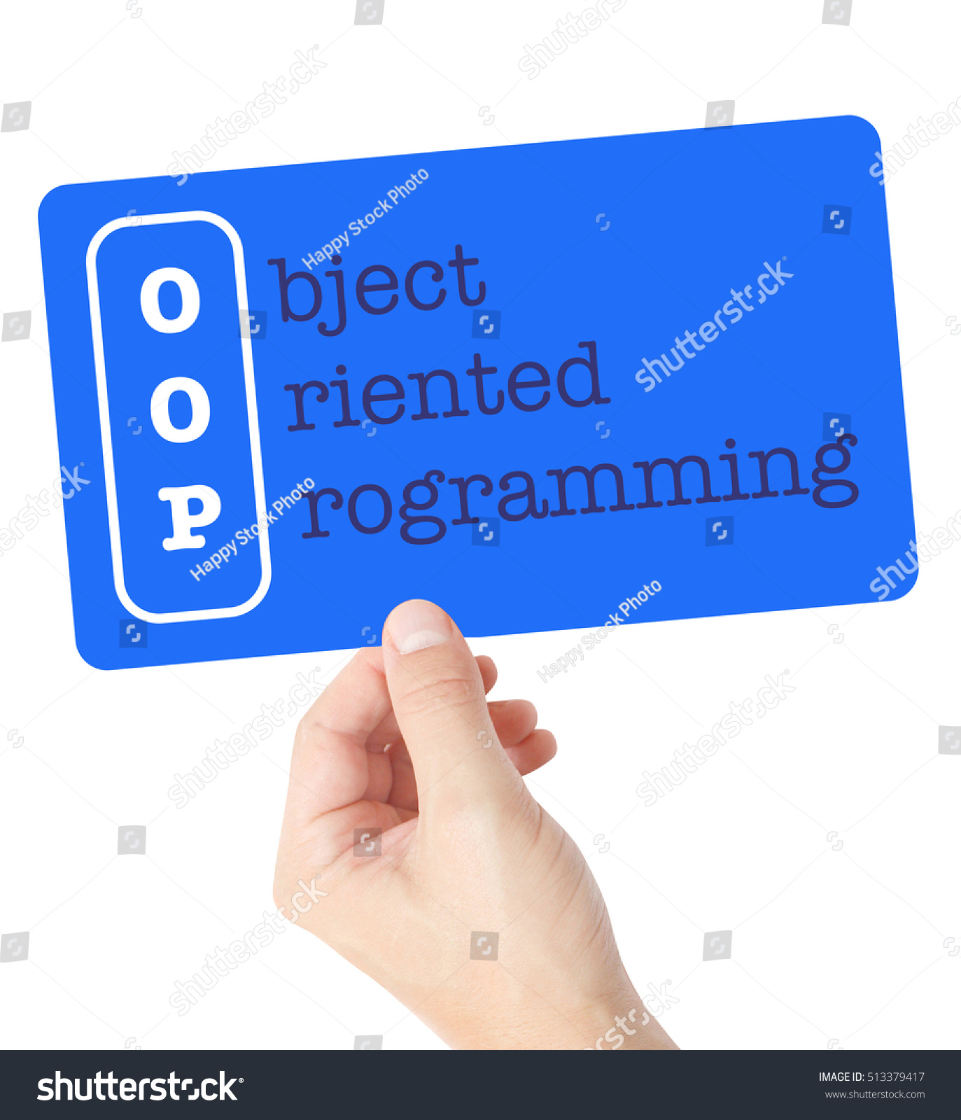
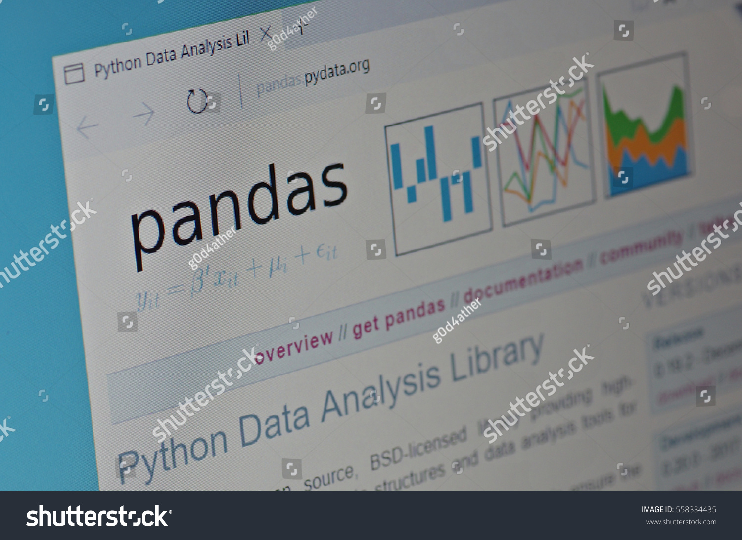
Why Python?
Robust Standard Library
Adaptive development
Object Oriented programming
Shutterstock ID: 558334435
ShutterStock ID: 513379417
Notes:
Explain each feature of Python
How adaptive quality of python is useful
Packages present in the library such as NumPy, Pandas, Matplotlib etc and what these packages are used for. Also mentioning some real examples such as visualisations done in the companies, data wrangling etc.
PyPI packages: 230,858

Slide 14
Python
Easy to learn, read and translate in comparison to other languages.
General-purpose and high-level programming language.
Allows you to focus on core functionality of the application by taking care of common programming tasks.
Note: To dig deeper on what is Python, please refer to the below link:
https://www.pythonforbeginners.com/learn-python/what-is-python/

Slide 15
Different IDEs and Code Editors for Python
PyCharm
Jupyter
Spyder
PyDev
Idle
Wing
Eric
Rodeo
Thonny
Additional Resource: To get in-depth knowledge of all the IDEs, please refer the below link.
https://www.softwaretestinghelp.com/python-ide-code-editors/

Slide 16
Why Anaconda?
Anaconda is an open-source distribution that simplifies package management and deployment. Package versions are managed by the package management system 'Conda'.
We strongly recommend using Anaconda to install Python as well as the packages, since it comes preloaded with most of the packages you’ll need.
Advantages of using Anaconda
Easy to manage and get started with most requirements for ML/AI problems
Anaconda comes with many libraries such as NumPy, OpenCV, SciPy, PyQt, the Spyder IDE, etc.

Slide 17
Key Takeaways
The programming language widely used in Data science is Python.
Python is a general-purpose and high-level programming language which allows you to focus on core functionality of the application by taking care of common programming tasks.
Different IDEs and Code Editors for Python
Why we will be using Anaconda.

Slide 18
Thank You!
Happy learning!
#LifeKoKaroLift

Slide 19
Module Name - Introduction to Python
Class - Day 2
Topic: Getting Started- Installation
EditEdit MasterMaster texttext stylesstyles

Slide 20
Time Allocation Summary
Element | Slides | Maximum time allowed (min)
Agenda | 21 | 5
Revision of Anaconda | 22 | 5
Installing Anaconda | 23 | 20
Jupyter Notebook | 24 | 7
How to use Jupyter Notebook | 25 | 20
Key takeaways | 26 | 3
Total Time |  | 60
Notes:
This slide is for instructor reference.

Slide 21
Revision of What and Why Anaconda?
Installing Anaconda
Getting Started with Jupyter

Slide 22
Why Anaconda?
Anaconda is an open-source distribution that simplifies package management and deployment. Package versions are managed by the package management system 'Conda'.
We strongly recommend using Anaconda to install Python as well as the packages, since it comes preloaded with most of the packages you’ll need.

Slide 23
Installing Anaconda
Anaconda can be downloaded from anaconda.org and can be installed like any other normal software.
There is no need to download Python separately; the Anaconda installer will do this for you. Make sure you select Python 3.x while downloading Anaconda.
Platform Path
Please download the installation guide from your learn platform. Follow the path:
Introduction to Python-Class ----> Introduction to Python ---->Getting Started - Installation

Slide 24
Jupyter Notebook
You’ll use the Jupyter IPython Notebook as the main environment for writing Python code throughout this program.
The main advantage of using Jupyter Notebook is that you can write both code and normal text (using the Markdown format in Jupyter) in the notebooks.
These notebooks are easy to read and share and can even be used to present your work to others.
Here’s a brief overview of Jupyter Notebook.
Note: Please refer to the previous guide for the same.

Slide 25
How to use Jupyter Notebook
The guide to the shortcuts used in Jupyter notebook are present on the platform for reference.
Platform Path
Please refer to the Jupyter IPython Notebook present on the platform. Follow the path:
Introduction to Python-Class ----> Introduction to Python ----> Introduction to Jupyter Notebook

Slide 26
Let’s attempt
Platform Path
Please attempt MCQs based on Jupyter notebook shortcuts present on the platform. Follow the path:
Introduction to Python ----> Introduction to Python ----> Introduction to Jupyter Notebook

Slide 27
Key Takeaways
Why we will be using Anaconda.
Anaconda Installed on the systems
What is Jupyter Notebook
The steps to use the Jupyter Notebook

Slide 28
Thank You!
Happy learning!
#LifeKoKaroLift

Slide 29
Module Name - Introduction to Python
Class - Day 3
Topic: Basic Operations and Data Structures
EditEdit MasterMaster texttext stylesstyles

Slide 30
Time Allocation Summary
Element | Slides | Maximum time allowed (min)
Agenda | 31 | 5
Introduction | 32 | 5
Basic Operations | 33 | 20
Let’s attempt | 34 | 5
Numbers | 35 | 10
Let’s attempt | 36 | 10
Key takeaways | 37 | 5
Total Time |  | 60
Notes:
This slide is for instructor reference.

Slide 31
Introduction to Basic operations and Data structures
Getting Started with Basic Operations
Getting Started with Numbers

Slide 32
Basic Operations and Data Structures
Operations:
Printing
Arithmetic
Logical
Object Types:
Numbers
Strings
Data Structures:
Lists
Dictionaries
Tuples
Sets

Slide 33
Basic Operations
Operations:
Printing
Arithmetic (BEDMAS rule)
Logical
Platform Path
Please refer to the Jupyter IPython Notebook present on the platform. Follow the path:
Introduction to Python - Class ----> Introduction to Python ----> Basic Operations

Slide 34
Let’s attempt
Platform Path
Please attempt MCQs based on Arithmetic Operators present on the platform. Follow the path:
Introduction to Python- Class ----> Introduction to Python ----> Basic Operations

Slide 35
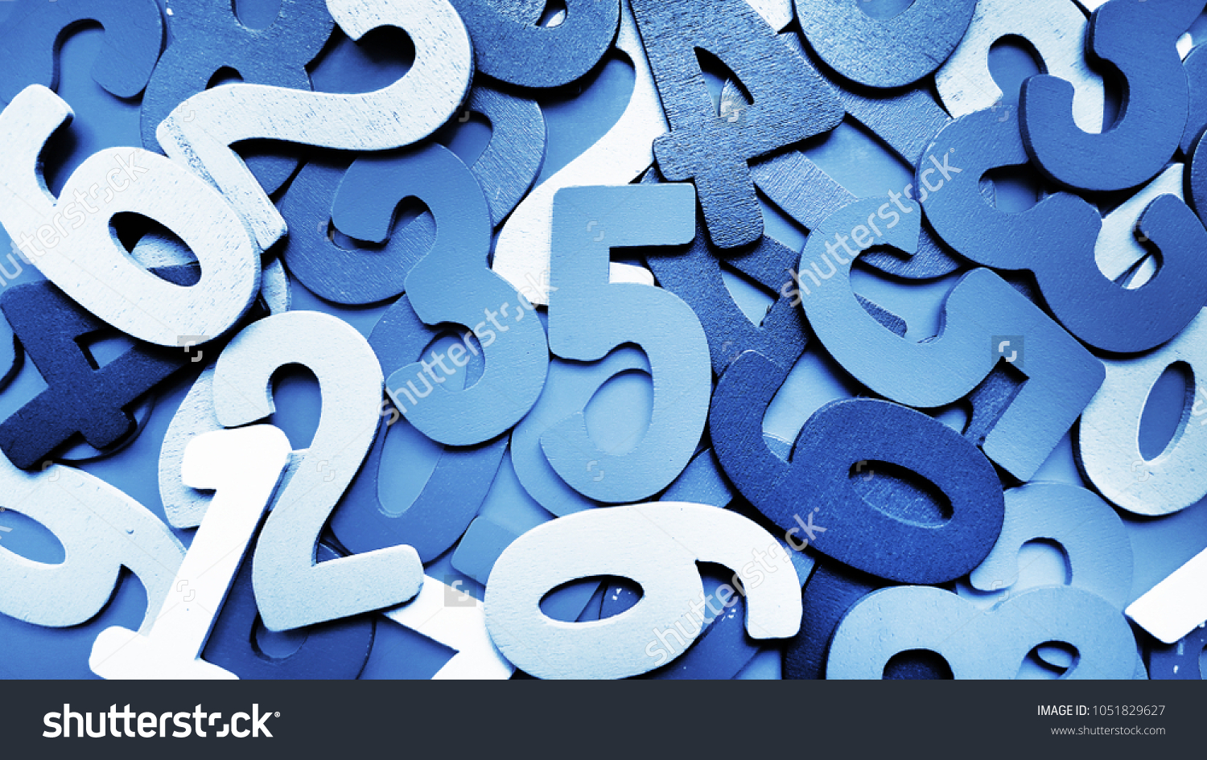
Object Types
Numbers
Python supports integers, floating point numbers and complex numbers.
Platform Path
Please refer to the Jupyter IPython Notebook downloaded before for Basic Operations.
Shutterstock ID: 1051829627

Slide 36
Let’s attempt
Platform Path
Note: Please attempt MCQs and coding questions based on Strings present on the platform. Follow the path:
Introduction to Python- Class ----> Introduction to Python ----> Basic Operations

Slide 37
Key Takeaways
Introduction to basics of Python
Operations in Python
Number and String data structure of Python

Slide 38
Thank You!
P.S. - Don’t forget the home assignment for today.
Introduction to Python- Home ----> Introduction to Python ----> Basic Operations
Happy learning!
#LifeKoKaroLift

Slide 39
Module Name - Introduction to Python
Class - Day 4
Topic: Basic Operations and Data Structures
EditEdit MasterMaster texttext stylesstyles

Slide 40
Time Allocation Summary
Element | Slides | Maximum time allowed (min)
Agenda | 41 | 5
Spot test | 42 | 10
Strings | 43 | 20
Let’s attempt | 44 | 20
Key takeaways | 45 | 5
Total Time |  | 60
Notes:
This slide is for instructor reference.

Slide 41
Revision of Basic Operations and Numbers
Getting Started with Strings

Slide 42
Spot Test
Let’s attempt a question to revise previous class.
Introduction to Python- Home ----> Introduction to Python ----> Basic Operations

Slide 43

Data Structures
Strings
A string is a sequence of characters.
Platform Path
Please refer to the Jupyter Notebook present on the platform. Follow the path:
Introduction to Python- Class ----> Introduction to Python ----> Strings
ShutterStock ID: 1539900608

Slide 44
Let’s attempt
Platform Path
Please attempt MCQs and coding questions based on Strings present on the platform. Follow the path:
Introduction to Python- Class ----> Introduction to Python ----> Strings

Slide 45
Key Takeaways
Revision of Basic Operations and Numbers
Strings

Slide 46
Thank You!
P.S. - Don’t forget the home assignment for today.
Introduction to Python- Home----> Introduction to Python ----> Strings
Happy learning!
#LifeKoKaroLift

Slide 47
Module Name - Introduction to Python
Class - Day 5
Topic: Basic Operations and Data Structures
EditEdit MasterMaster texttext stylesstyles

Slide 48
Time Allocation Summary
Element | Slides | Maximum time allowed (min)
Agenda | 49 | 5
Spot test | 50 | 10
Strings | 51 | 20
Let’s attempt | 52 | 20
Key takeaways | 53 | 5
Total Time |  | 60
Notes:
This slide is for instructor reference.

Slide 49
Revision of Strings
More operations on Strings

Slide 50
Spot Test
Let’s attempt a question
Introduction to Python- Home----> Introduction to Python ----> Strings

Slide 51
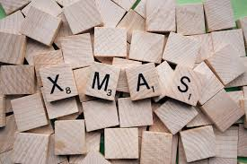
Data Structures
Strings
Platform Path
Note: Please refer to the Jupyter IPython Notebook downloaded in the previous class.

Slide 52
Let’s attempt
Platform Path
Note: Please attempt MCQs and coding questions based on Strings present on the platform. Follow the path:
Introduction to Python- Class ----> Introduction to Python ----> Strings

Slide 53
Key Takeaways
Revision of Strings
More operations on Strings

Slide 54
Thank You!
P.S. - Don’t forget the home assignment for today.
Introduction to Python- Home----> Introduction to Python ----> Strings
Happy learning!
#LifeKoKaroLift

Slide 55
Module Name - Introduction to Python
Class - Day 6
Topic: Basic Operations and Data Structures
EditEdit MasterMaster texttext stylesstyles

Slide 56
Time Allocation Summary
Element | Slides | Maximum time allowed (min)
Agenda | 57 | 2
Spot Test | 58 | 10
Lists | 59-60 | 25
Let’s attempt | 61 | 20
Key takeaways | 62 | 3
Total Time |  | 60
Notes:
This slide is for instructor reference.

Slide 57
Revision of Strings
Lists
Let’s attempt

Slide 58
Spot Test
Numbers - You learned about the types of numbers Python supports ( integers, floating point numbers and complex numbers) ; the Binary, Octal, and Hexadecimal representations ; how to do type conversion
Strings - You learned about various functions such as strip function, lower, upper, find, replace and you also learned the concepts of slicing and indexing.
Let’s attempt a question.
Introduction to Python- Home----> Introduction to Python ----> Strings

Slide 59

What does this image indirectly instructs you to do?
When you see the image you think of making a list.
ShutterStosck ID: 384639760

Slide 60
Data Structures
Lists
Lists are the most commonly used data structure.
Think of it as a sequence of data that is enclosed in square brackets and data are separated by a comma.
Each of these data can be accessed by calling it's index value.
Lists are declared by just equating a variable to '[ ]' or list.
We can use lists to hold an ordered sequence of values.
Platform Path
Please refer to the Jupyter IPython Notebook present on the platform. Follow the path:
Introduction to Python- Class ----> Introduction to Python -----> Lists

Slide 61
Let’s attempt
Platform Path
Note: Please attempt MCQs and coding questions based on Lists present on the platform. Follow the path:
Introduction to Python- Class ----> Introduction to Python -----> Lists

Slide 62
Key Takeaways
Revisiting the concept of strings
Lists data structure and various concepts and operations of the Lists

Slide 63
Thank You!
P.S. - Don’t forget the home assignment for today.
Introduction to Python- Home----> Introduction to Python -----> Lists
Happy learning!
#LifeKoKaroLift

Slide 64
Module Name - Introduction to Python
Class - Day 7
Topic: Basic Operations and Data Structures
EditEdit MasterMaster texttext stylesstyles

Slide 65
Time Allocation Summary
Element | Slides | Maximum time allowed (min)
Agenda | 66 | 2
Spot Test | 67 | 10
Lists | 68 | 25
Let’s attempt | 69 | 20
Key takeaways | 70 | 3
Total Time |  | 60
Notes:
This slide is for instructor reference.

Slide 66
Revision of Lists
More operations on Lists
Let’s attempt

Slide 67
Spot Test
Let’s attempt a question to revise previous class.
Introduction to Python- Home----> Introduction to Python -----> Lists

Slide 68

Data Structures
Lists
Platform Path
Note: Please refer to the Jupyter IPython
Notebook downloaded in the previous class.
ShutterStock ID: 431923516

Slide 69
Let’s attempt
Platform Path
Note: Please attempt MCQs and coding questions based on Lists present on the platform. Follow the path:
Introduction to Python- Class ----> Introduction to Python -----> Lists

Slide 70
Key Takeaways
Revisiting the concept of Lists
More operations on Lists

Slide 71
Thank You!
P.S. - Don’t forget the home assignment for today.
Introduction to Python- Home----> Introduction to Python -----> Lists
Happy learning!
#LifeKoKaroLift

Slide 72
Module Name - Introduction to Python
Class - Day 8
Topic: Basic Operations and Data Structures
EditEdit MasterMaster texttext stylesstyles

Slide 73
Time Allocation Summary
Element | Slides | Maximum time allowed (min)
Agenda | 74 | 5
Revision | 75 | 10
Tuples | 76 | 20
Let’s attempt | 77 | 20
Key takeaways | 78 | 5
Total Time |  | 60
Notes:
This slide is for instructor reference.

Slide 74
Revision of Numbers and Strings
Tuples
Let’s attempt

Slide 75
Revision
Lists- In previous classes, you learned about a data structure called Lists which stores a series of items in a particular order. You also went through the various concepts such as declaring, slicings the lists and various functions such as append, remove, split.
Let’s attempt a question on Lists.
Introduction to Python- Home----> Introduction to Python -----> Lists

Slide 76
Data Structures
Tuples
Tuples are another way to combine different values.
The combined values can be of different types.
Like lists, they have a well-defined ordering and can be indexed.
To create a tuple in Python, use round brackets instead of square brackets
Platform Path
Please refer to the Jupyter IPython Notebook present on the platform. Follow the path:
Introduction to Python- Class ----> Introduction to Python ----> Tuples
Notes:
When should we use tuples? https://www.programiz.com/python-programming/list-vs-tuples#usage
When and why do we need immutability? https://medium.com/@geekgirldecodes/tuples-in-python-art-of-mutability-and-immutability-3bd959a5b21d
http://radar.oreilly.com/2014/10/python-tuples-immutable-but-potentially-changing.html

Slide 77
Let’s attempt
Platform Path
Please attempt MCQs and coding questions based on Lists present on the platform. Follow the path:
Introduction to Python- Class ----> Introduction to Python ----> Tuples

Slide 78
Key Takeaways
Revisiting the concept of Lists
Tuples data structure and various concepts and operations of the Tuple.

Slide 79
Thank You!
P.S. - Don’t forget the home assignment for today.
Introduction to Python- Home ----> Introduction to Python ----> Tuples
Happy learning!
#LifeKoKaroLift

Slide 80
Module Name - Introduction to Python
Class - Day 9
Topic: Basic Operations and Data Structures
EditEdit MasterMaster texttext stylesstyles

Slide 81
Time Allocation Summary
Element | Slides | Maximum time allowed (min)
Agenda | 82 | 5
Revision | 83 | 10
Dictionaries | 84-86 | 20
Let’s attempt | 87 | 20
Key takeaways | 88 | 5
Total Time |  | 60
Notes:
This slide is for instructor reference.

Slide 82
Revision of Tuples
Dictionaries
Let’s attempt

Slide 83
Revision
Tuples - In the previous class, you learned about a data structure called Tuples which is similar to lists, but the items in a tuple can't be modified (immutable). You also went through the various concepts such as declaring, slicings the tuples and various functions such as len, max, min etc.
Let’s attempt a question on Tuples.
Introduction to Python- Home----> Introduction to Python ----> Tuples

Slide 84
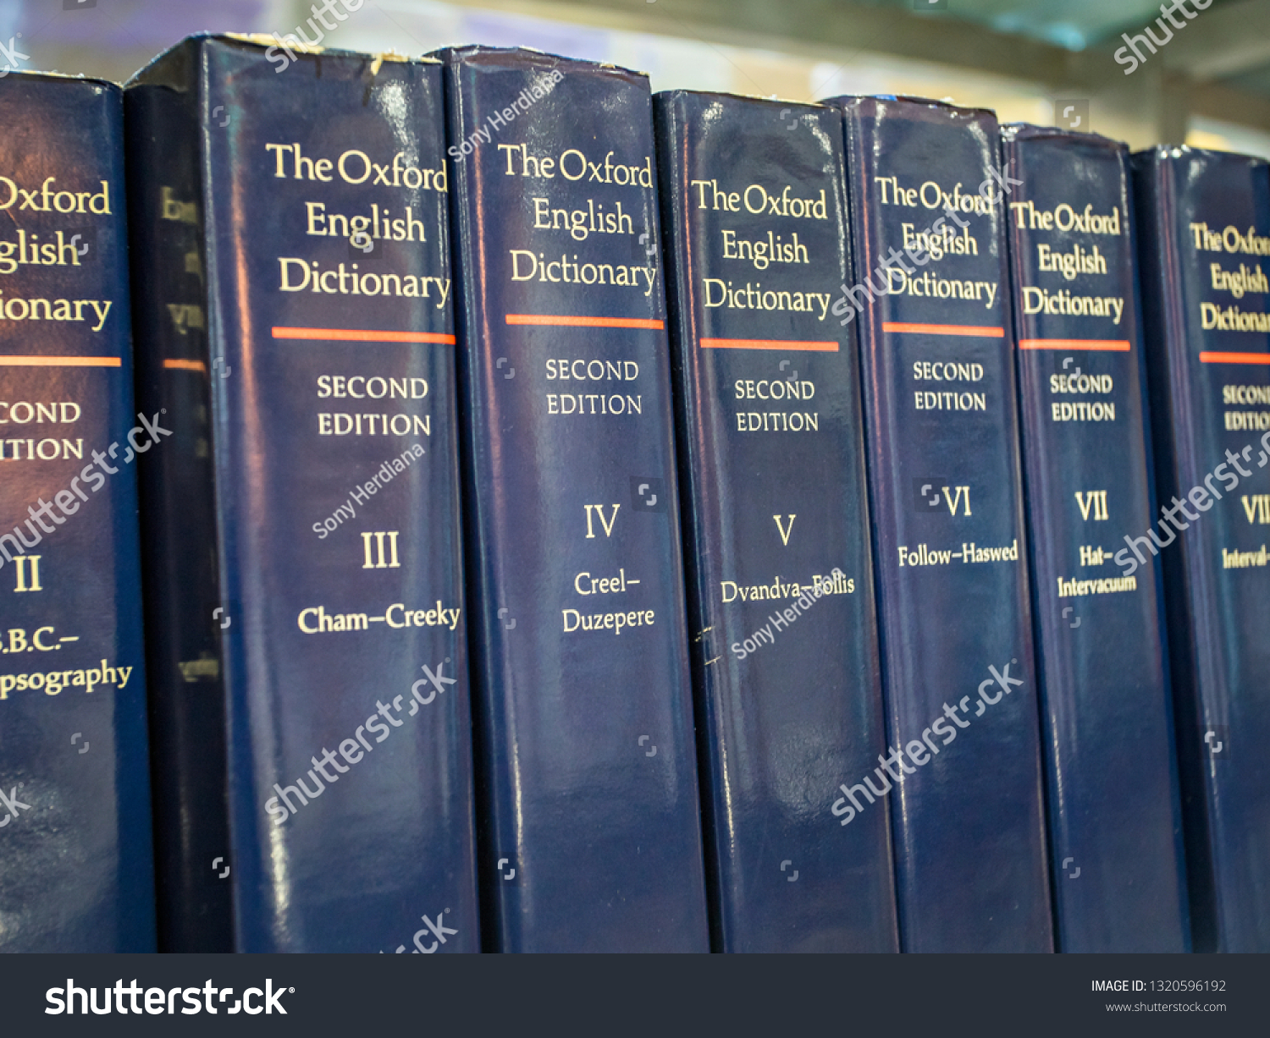
Dictionaries
The first thing that comes to mind when you hear about dictionaries is the Oxford dictionary, where you can look up meanings of words.
So, you can imagine how dictionaries work.
ShutterStock ID: 1320596192

Slide 85
Data Structures
A dictionary is a collection of words along with their meanings or simpler explanations.
At a broader level, you could call a dictionary a mapping of words with their synonyms or meanings.
In Python, each item in a dictionary is a key-value pair.
Dictionaries are more used like a database because here you can index a particular sequence with your user defined string.
To define a dictionary, equate a variable to { } or dict()

Slide 86
Data Structures
Let’s learn about dictionariories in python and its functionalities
Platform Path
Please refer to the Jupyter IPython Notebook present on the platform. Follow the path:
Introduction to Python- Class ----> Introduction to Python -----> Dictionaries

Slide 87
Let’s attempt
Platform Path
Note: Please attempt MCQs and coding questions based on Lists present on the platform. Follow the path:
Introduction to Python- Class ----> Introduction to Python -----> Dictionaries

Slide 88
Key Takeaways
Revisiting the concept of Tuple
Dictionaries data structure and various concepts and operations of the Dictionary.

Slide 89
Thank You!
P.S. - Don’t forget the home assignment for today.
Introduction to Python- Home----> Introduction to Python -----> Dictionaries
Happy learning!
#LifeKoKaroLift

Slide 90
Module Name - Introduction to Python
Class - Day 10
Topic: Basic Operations and Data Structures
EditEdit MasterMaster texttext stylesstyles

Slide 91
Time Allocation Summary
Element | Slides | Maximum time allowed (min)
Agenda | 92 | 2
Revision + Spot Test | 93 | 16
Sets | 94-96 | 20
Let’s attempt | 97 | 20
Key takeaways | 98 | 2
Total Time |  | 60
Notes:
This slide is for instructor reference.

Slide 92
Revision of Tuples
Dictionaries
Let’s attempt

Slide 93
Revision
Dictionaries - In the previous you learned about a data structure called Dictionaries which stores connections between pieces of information. Each item in a dictionary is a key-value pair. You also went through the various concepts such as declaring, slicings the lists and various functions such as update, pop, get.
Let’s attempt a question on Dictionaries.
Introduction to Python- Home----> Introduction to Python -----> Dictionaries

Slide 94
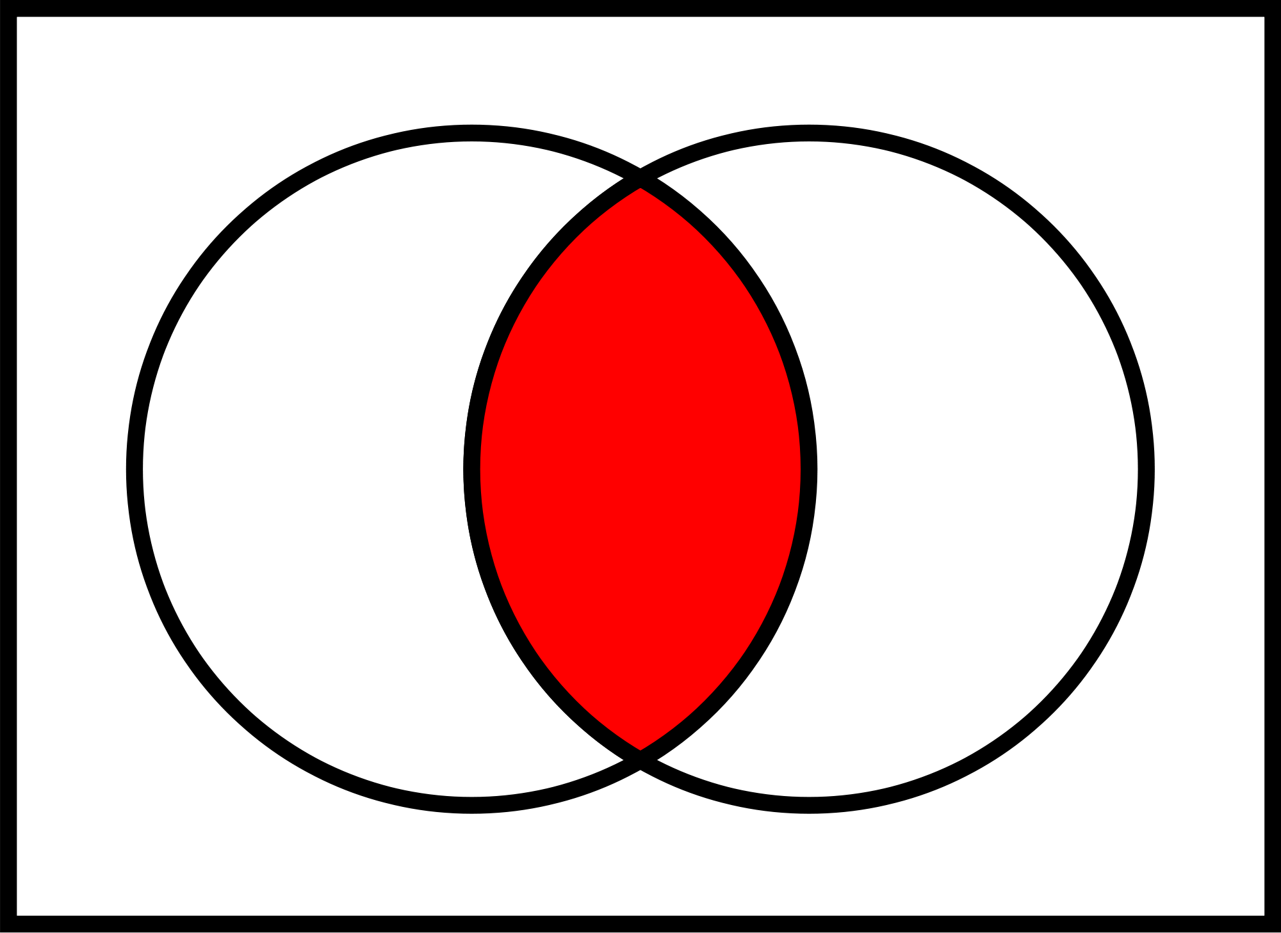
Sets
The last type of data structure we will look at is 'sets'.
Sets are a good way to get the unique elements out of a collection or to find common elements in various collections.

Slide 95
Sets
Using sets is quick and can help solve tasks requiring deduplication.
A set is a collection which is unordered and unindexed.
Sets are mainly used to eliminate repeated numbers in a sequence/list.
It is also used to perform some standard set operations.
Sets are declared as set() which will initialize a empty set.

Slide 96
Sets
Let’s learn about programming in Python using Sets.
Platform Path
Note: Please refer to the Jupyter IPython Notebook present on the platform. Follow the path:
Introduction to Python- Class ----> Introduction to Python ----> Sets

Slide 97
Let’s attempt
Platform Path
Note: Please attempt MCQs and coding questions based on Lists present on the platform. Follow the path:
Introduction to Python- Class ----> Introduction to Python ----> Sets

Slide 98
Key Takeaways
Revisiting the concept of Dictionary
Sets data structure and various concepts and operations of the Set.

Slide 99
Thank You!
P.S. - Don’t forget the home assignment for today.
Introduction to Python- Home ----> Introduction to Python ----> Sets
Happy learning!
#LifeKoKaroLift

Slide 100
Module Name - Introduction to Python
Class - Day 11
Topic: Control Structure
EditEdit MasterMaster texttext stylesstyles

Slide 101
Time Allocation Summary
Element | Slides | Maximum time allowed (min)
Agenda | 102 | 5
Spot Test | 103 | 10
If-else and Switch | 104-106 | 20
Let’s attempt | 107 | 20
Key takeaways | 108 | 5
Total Time |  | 60
Notes:
This slide is for instructor reference.

Slide 102
Revision of Data Structure
If-Else
Let’s attempt

Slide 103
Spot Test
Let’s attempt a question on Sets.
Introduction to Python- Home ----> Introduction to Python ----> Sets

Slide 104
Control Structures
If- Else
if <condition 1>:
do something
elif <condition 2>:
do something else
else:
do something else
if <condition 1>:
do something
if <condition 1>:
do something
else:
do something else

Slide 105
Control Structures
Switch Statement
<Name of object for example: switcher> = {
<Case name> : <Statement>
…. }

Slide 106
Control Structures
Let’s go through the If-Else and Switch statement coding in Python.
Platform Path
Note: Please refer to the Jupyter IPython Notebook present on the platform. Follow the path:
Introduction to Python- Class ----> Control Structure ----> If-Else

Slide 107
Let’s attempt
Platform Path
Note: Please attempt MCQs and coding questions based on Lists present on the platform. Follow the path:
Introduction to Python- Class ----> Control Structure ----> If-Else

Slide 108
Key Takeaways
Revisiting the Data Structures
Syntax of If-Else
Syntax Switch Statement
Hands-on of both

Slide 109
Thank You!
P.S. - Don’t forget the home assignment for today.
Introduction to Python- Home----> Control Structure ----> If-Else
Happy learning!
#LifeKoKaroLift

Slide 110
Module Name - Introduction to Python
Class - Day 12
Topic: Control Structure
EditEdit MasterMaster texttext stylesstyles

Slide 111
Time Allocation Summary
Element | Slides | Maximum time allowed (min)
Agenda | 112 | 5
Spot Test | 113 | 10
For Loop | 114 | 10
While Loop | 115 | 10
Let’s attempt | 116 | 20
Key takeaways | 117 | 5
Total Time |  | 60
Notes:
This slide is for instructor reference.

Slide 112
Revision of If-Else and Switch Statement
For loop
While Loop
Let’s attempt

Slide 113
Spot Test
Let’s attempt a question on If-Else.
Introduction to Python- Home----> Control Structure ----> If-Else

Slide 114
Control Structures
For Loop
for <variable name> in <specify the range> :
<Statements>
Platform Path
Note: Please refer to the Jupyter IPython Notebook present on the platform. Follow the path:
Introduction to Python- Class ----> Control Structure ----> Loops

Slide 115
Control Structures
While Loop
while <variable name> <Condition> :
<Statements>
Platform Path
Note: Please refer to the Jupyter IPython Notebook used for “FOR” loop.

Slide 116
Let’s attempt
Platform Path
Note: Please attempt MCQs and coding questions based on Lists present on the platform. Follow the path:
Introduction to Python- Class ----> Control Structure ----> Loops

Slide 117
Key Takeaways
Revisiting the concept of If- else and switch
For Loop
While Loop

Slide 118
Thank You!
P.S. - Don’t forget the home assignment for today.
Introduction to Python- Home ----> Control Structure ----> Loops
Happy learning!
#LifeKoKaroLift

Slide 119
Module Name - Introduction to Python
Class - Day 13
Topic: Control Structure
EditEdit MasterMaster texttext stylesstyles

Slide 120
Time Allocation Summary
Element | Slides | Maximum time allowed (min)
Agenda | 121 | 5
Revision | 122 | 10
User-Input and Comprehension | 123 | 20
Let’s attempt | 124 | 20
Key takeaways | 125 | 5
Total Time |  | 60
Notes:
This slide is for instructor reference.

Slide 121
Revision of For and while loop
User-Input and Comprehension
Let’s attempt

Slide 122
Revision
Let’s attempt a question to for revision.
Introduction to Python- Home ----> Control Structure ----> Loops

Slide 123
Control Structures
User- Input and Comprehension
Python comprehensions are syntactic constructs that enable sequences to be built from other sequences in a clear and concise manner.
Platform Path
Note: Please refer to the Jupyter IPython Notebook present on the platform. Follow the path:
Introduction to Python- Class ----> Control Structure ----> Comprehension

Slide 124
Let’s attempt
Platform Path
Note: Please attempt MCQs and coding questions based on Lists present on the platform. Follow the path:
Introduction to Python- Class ----> Control Structure ----> Comprehension

Slide 125
Key Takeaways
Revisiting the concept of Nesting
Comprehension and how to take User-Input

Slide 126
Thank You!
P.S. - Don’t forget the home assignment for today.
Introduction to Python- Home----> Control Structure ----> Comprehension
Happy learning!
#LifeKoKaroLift

Slide 127
Module Name - Introduction to Python
Class - Day 14
Topic: Functions
EditEdit MasterMaster texttext stylesstyles

Slide 128
Time Allocation Summary
Element | Slides | Maximum time allowed (min)
Agenda | 129 | 5
Spot Test | 130 | 10
Function | 131 | 20
Let’s attempt | 132 | 20
Key takeaways | 133 | 5
Total Time |  | 60

Slide 129
Revision of User-Input and Comprehension
Functions
Let’s attempt

Slide 130
Spot Test
Let’s attempt a question for revision.
Introduction to Python- Home----> Control Structure ----> Comprehension

Slide 131
Functions
Functions, as the name suggests, perform a task or function.
They are blocks of code that can be reused at various parts of the code as well as various files.
When you import any package and call any of its methods, you make use of the functions defined in it.
Platform Path
Please refer to the Jupyter IPython Notebook present on the platform. Follow the path:
Introduction to Python- Class ----> Function ----> Introduction to Function

Slide 132
Let’s attempt
Platform Path
Note: Please attempt MCQs and coding questions based on Lists present on the platform. Follow the path:
Introduction to Python- Class ----> Function ----> Introduction to Function

Slide 133
Key Takeaways
Revisiting the concept of Comprehension and how to take User-Input
Functions (lambda, map, reduce and filter)

Slide 134
Thank You!
P.S. - Don’t forget the home assignment for today.
Introduction to Python- Home----> Function ----> Introduction to Function
Happy learning!
#LifeKoKaroLift

Slide 135
Module Name - Introduction to Python
Class - Day 15
Topic: Functions
EditEdit MasterMaster texttext stylesstyles

Slide 136
Time Allocation Summary
Element | Slides | Maximum time allowed (min)
Agenda | 137 | 2
Spot Test | 138 | 6
User-Defined Functions | 139 | 15
Classes | 140 | 15
Let’s attempt | 141 | 20
Key takeaways | 142 | 2
Total Time |  | 60

Slide 137
Revision of Functions
User-Defined Functions
Classes
Let’s attempt

Slide 138
Spot Test
Let’s attempt a question for revision.
Introduction to Python- Home----> Function ----> Introduction to Function

Slide 139
User-Defined Function
For defining a function in Python, we write
def <Function Name> (<arguments if any otherwise empty>):
<Statements>
Platform Path
Please refer to the Jupyter IPython Notebook present on the platform. Follow the path:
Introduction to Python- Class ----> Function ----> User-Defined Function

Slide 140
Classes
A class is a blueprint of an application, where you implement methods (to perform certain actions/functionalities) and declare variables (that describe the properties of the application).
What are objects?
Class is a blueprint and objects are the blocks built upon this blueprint with certain state and behaviour.
Platform Path
Note: Please refer to the Jupyter IPython Notebook of User-defined function

Slide 141
Let’s attempt
Platform Path
Note: Please attempt MCQs and coding questions based on Lists present on the platform. Follow the path:
Introduction to Python-Class ----> Function ----> User-Defined Function

Slide 142
Key Takeaways
Revisiting the concept of Function
Concept of User-Defined Functions
Concept of Classes

Slide 143
Thank You!
P.S. - Don’t forget the home assignment for today.
Introduction to Python- Home ----> Function ----> User-Defined Function
Happy learning!
#LifeKoKaroLift

Slide 144
Module Name - Introduction to Python
Class - Day 16
Topic: Errors
EditEdit MasterMaster texttext stylesstyles

Slide 145
Time Allocation Summary
Element | Slides | Maximum time allowed (min)
Agenda | 146 | 2
Revision | 147 | 5
Errors | 148-149 | 30
Key takeaways | 150 | 3
Total Time |  | 60
Notes:
This slide is for instructor reference.

Slide 146
Revision of User-Defined Functions and Classes
Errors
Let’s attempt

Slide 147
Revision
Let’s attempt a question for revision.
Introduction to Python- Home ----> Function ----> User-Defined Function

Slide 148

ShutterStock ID: 1302310741
What comes to your mind when you see this symbol ?

Slide 149
Error
Let’s see what error messages one can get in Python.
URLs
Note: Please refer to the documentation for errors
https://docs.python.org/3/tutorial/errors.html

Slide 150
Key Takeaways
Revisiting the concept of User-Defined and Classes
Errors

Slide 151
Thank You!
P.S. - Don’t forget the home assignment for today.
Happy learning!
#LifeKoKaroLift

